Slide 1
Medical Cosmetic
Member and Queue Manage
By Idan Golan

Slide 2
About
This website will manage queues for customers cosmetics and medical-cosmetic treatments
The front-end side will be develop with React
The back-end side will be develop with C#
The customer database will be managed with SQL Server
The project will be managed with GIT and backed up on GitHub

Slide 3
Website Subject and Theme
Site that manage cosmetics treatment queues
Managing queues by making, editing and canceling appointments
Managing users with the ability to customize certain properties

Slide 4
Features
Customers can register users to login to, presents upcoming queues and treatments
Customer can change date of upcoming queue and cancel it
There will be no on-site payment

Slide 5
Queue
Every user can have 1 queue
The user can select a date from a calendar of available queues
If the user select another queue while he have one, it will overwritten the last queue if the user decides so.

Slide 6
Page Layout
Home
Login
Register
Profile
About
Contact

Slide 7

Home Page

Slide 8
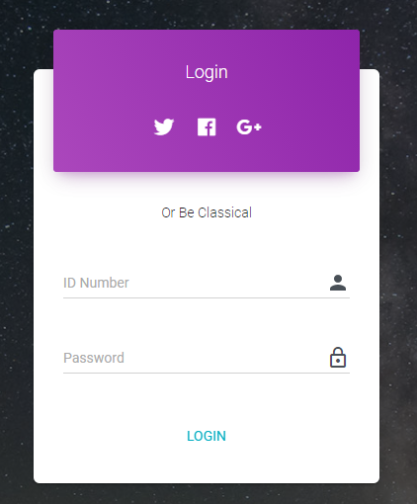
Login Page
Login will require:
ID Number
Password

Slide 9
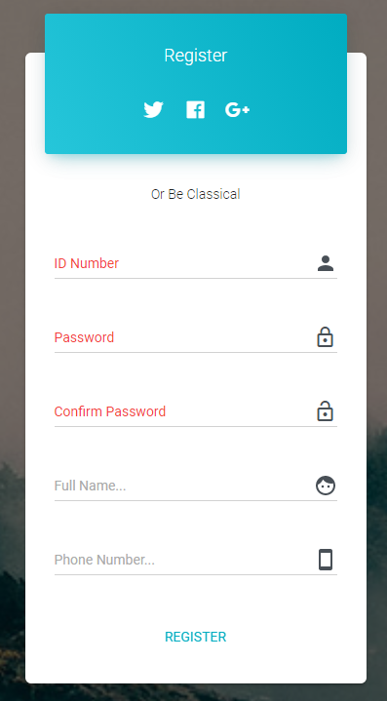
Register Page
Register will require:
User Name
Password
Name
Phone Number

Slide 10
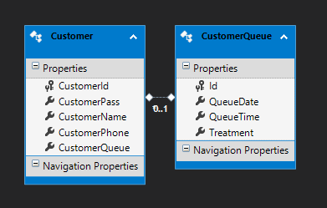
SQL Table

Slide 11
Users
Dev
Customer
Developer – Full access
Customer – Basic User, Access to basic actions of the site

Slide 12
End

